Slide 1
DataSpark: Illuminating Insights for Global Electronics
Capstone Project – 2
Presented By:
Durga Kannan

Slide 2
Executive Summary
Project overview
Conduct a comprehensive Exploratory Data Analysis (EDA) and utilize Power BI visualizations to extract actionable insights from Global Electronics' datasets, ultimately aiming to enhance customer satisfaction, optimize operations, and drive business growth.
Key objective
The project aims to enhance marketing strategies and improve sales forecasting. It will also focus on developing better products based on customer feedback, planning effective promotions, supporting strategic store expansions, and refining international pricing strategies. These objectives will collectively drive customer satisfaction and business growth for Global Electronics.

Slide 3
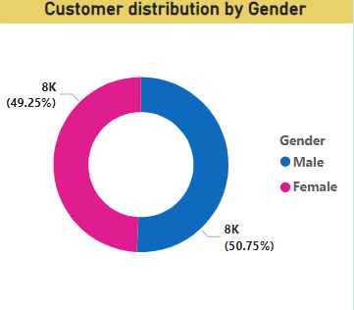
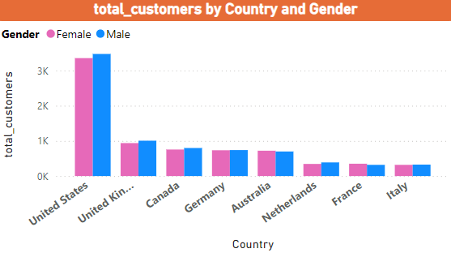
Analysis and Insights
Customer Analysis gender wise
The data indicates that male customers significantly outnumber the female customers with a slight difference, by Targeting advertisements aimed at women could help address this imbalance and boost overall sales.
Customer Analysis Country wise
United States customer dominance is higher compared to United Kingdom, Canada, Germany and Australia. Least Customers were from Netherlands, France and Italy.
Collaborating with local influencers, local brands and by conducting competitive analysis to adopt some strategies we can enhance customer acquisition.

Slide 4
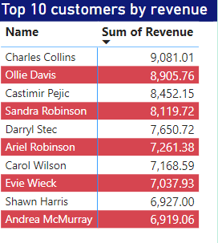
Analysis of top customers by Revenue
Charles Collins ,Ollie Davis and Castimir Pejic were top 3 customers contributing to sum of revenue.
Analyse top customer purchase history and recommend relevant products based on their preferences and provide these customers with personalized offers can strengthen their loyalty.
Encouraging top customers to refer others by offering incentives like discounts and gifts .

Slide 5
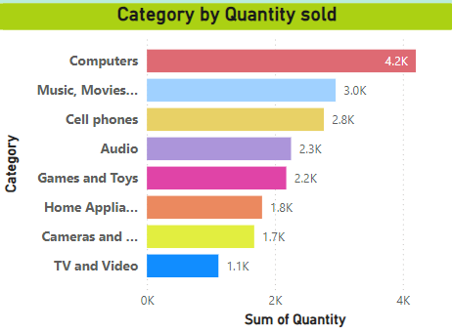
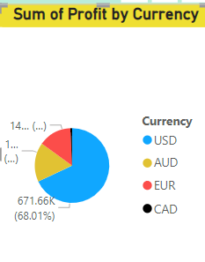
Sales Analysis by Category
Computers were the top category by the Quantity sold, Tv and video were the least sold. Ensure adequate stock levels for high demand categories and create a bundles of combining high performing items with low performing items, also offering discounts on low performing will boost sales across categories.
Sales Analysis by Currency
Sum of profit for USD currency was 68.01% , followed by:
EUR: 16.96%
GBP: 14.35%
CAD: 0.68%
Profit on USD currency was higher compared to other currency. Use currency optimization Strategy like monitoring fluctuations in exchange rate and adjusting local pricing based on the strength of currency to maintain profitability

Slide 6
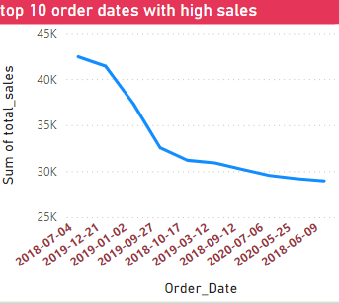
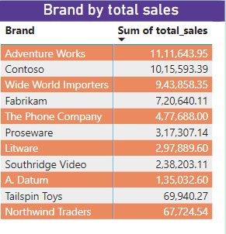
Sales analysis by Trends in order Dates
Combined revenue and Sales from 2018 and 2019 is higher than the total revenue from the other Period of year.
Plan sales recovery on low sales periods by launching new products, discounts and promotions to revive the decline in trends. Focus on causes for decline in trends and address those issue in future campaigns.
Sales analysis by brands
Top performing brand was Adventure Works by its total sales followed by Contoso and the least was Northwind Traders.
If customers are drawn into fewer top brands, consider diversifying the product lineup to reduce dependency .

Slide 7
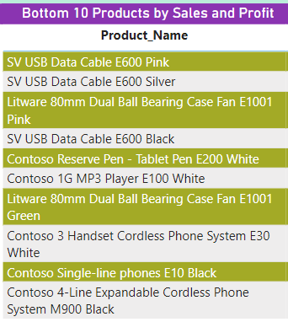
Product analysis by sales and profit
Top performing Products were Adventure Works 52" LCD HDTV X590 Black, and the least performing products were SV USB Data Cable E600 Pink
Promote the specific features or benefits of the least selling products. Combine least selling products with popular products and create a package deals.
Get feedback on least popular products and consider enhancing its features, design and quality to meet customers' expectations.

Slide 8
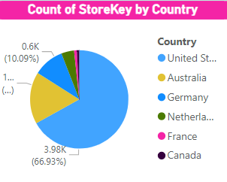
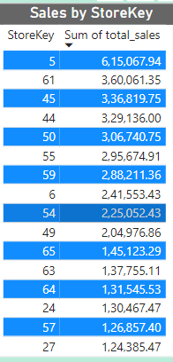
Store analysis by country and sales
US has high no of stores by 66.93% compared to Australia with 17.07% . Stores with Store Key “5” contribute to the highest sales and revenue
For countries like France and Canada with less no of stores consider setting up pop up stores in strategic locations such as busy shopping places. In countries with fewer stores Franchising could be of low risk to improve business growth
Forecast data to find high demand products in different region and ensure that stores are stocked with right products. Invest in training local staffs a well-trained local staff can offer personized service and boost customer satisfaction leading to higher sales.

